Slide 1

Software Defined Network Through automation
Ismael “Izzy” Ibarra
ACME Technologies

Slide 2
Agenda
Introduction
Software-Defined Network (SDN)
Automation Tasks
Benefits
Summary
References

Slide 3
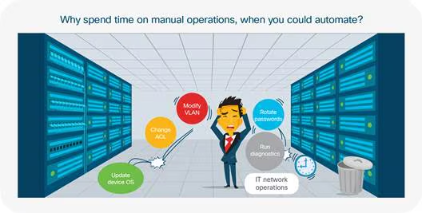
Introduction
Image credit: (Lawrence, 2018)

Slide 4
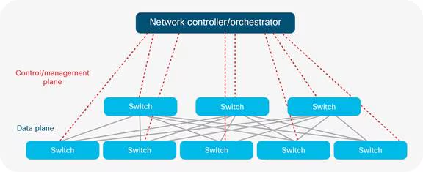
Software-defined network (SDN)
Traditionally, network devices tightly connect control functions with physical hardware, but SDN separates the control plane from physical devices, making network management more flexible and programmable. SDN unifies the management and control of various network software elements.
Image credit: (Lawrence, 2018)

Slide 5
Automation tasks
Inventory
Device Provisioning
Software Upgrades
Policy Enforcement
Monitoring Analytics
Detect Issues and Anomalies
Access Control Updates

Slide 6
benefits
Centralized Network Control
Vendor Format Conversion
Faster Efficient Operations
Lower Operational Costs
Eliminates Travel

Slide 7
summary
Software-Defined Network (SDN)
Automation Tasks
Benefits

Slide 8
references
Terry Slattery (March 25, 2025). 12 network automation ideas to implement in your network,
https://www.techtarget.com/searchnetworking/tip/12-network-automation-ideas-to-incorporate-in-your-network
Vincent Chosen (October 5, 2023). What is Network Automation? An Explanatory Guide
https://netboxlabs.com/blog/network-automation/
ZPE Systems (n.d.a.). How Automated Network Management Helps in the Remediation of Human Error
https://zpesystems.com/automated-network-management-zs/
Bob Stovall (2021). Utilizing automation saves jobs by enabling our technical teams to focus on growth.
https://www.merit.edu/about/news/networking-automation-the-must-have-provision-for-a-growing-network/
Nat Lawrence (January 5, 2018 ). SDN and its Role in Automating & Scaling in the Data Center
https://www.cisco.com/c/en/us/solutions/collateral/enterprise/cisco-on-cisco/cs-en-08022017-sdn-thesis.html

